Slide 1


Oriental College of Technology
Department of Computer Science
(recipe searching and sharing site)
Guide:
Asst. Prof. Syed Rameez Ali
Developed by:
GROUP 05
Moulsiri Awasthi (0126CS191062)
Pranjul Mishra (0126CS191076)

Slide 2
Modules
MODULE 01 :
Idea
Planning
System requirements
Prototype design
(Front end part)
UI design
Developing with html5 css3 and Javascript
MODULE 02 :
(Back end part)
Database Management
Laying the pipelines
Creating Dynamic Templates
(deployment part)

Slide 3
Introduction
“A recipe has no soul. You as the cook, must bring soul to the recipe.”
-Thomas Keller
Finding recipes with all ingredients available at home is difficult some time. Like we always choose a dish and than go to market for it’s ingredients but think of the situation when we have some ingredients at home and we want to make some interesting meal from them. That creates a lot of confusion to what to make . Our site AAHAR solve this problem, it will provide different unique recipes of your test made with all those ingredients which you want to add. It will also give you the feel of social media, that you can add yours too and like and save your fav cook’s recipes.

Slide 4
Objective
Social media site for only recipes, in which user can create their profile, share their own recipes in the form of text and video and last but not least anyone can find it.
Provide recipes for given Ingredients
Connect with other peoples
All Indian dishes in one platform
Share your recipes
Ease for people (get any dish at one place)

Slide 5
Proposed Idea
Our Idea is to give the user a platform where anyone can upload there own recipes
And get any type of recipes from that collection of the recipes that is mainly uploaded by the other peoples.
In this way anyone can connect with other people and get the unique taste .

Slide 6
Intended Audiences: Woman, children, students and anyone who want to cook some unique taste with the ingredients available in there home that is (no need to go outside to buy)
Project Scope: Right now we don’t expect much users for our site, so it’ll has an interactive front end with features like anyone can login, sign up, create there profile, upload there recipes in form of text, search all that uploaded recipes.

Slide 7
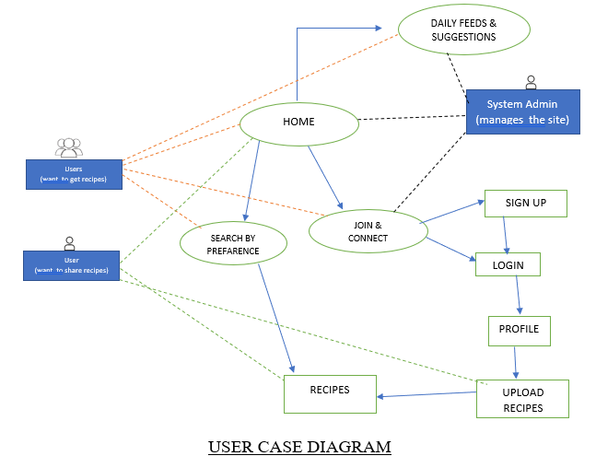

Slide 8
Software Development Lifecycle
The Agile Model
The Agile model believes that every project needs to be handled differently and the existing methods need to be tailored to best suit the project requirements. In Agile, the tasks are divided into time boxes (small time frames) to deliver specific features for a release. Iterative approach is taken and working software build is delivered after each iteration. Each build is incremental in terms of features; the final build holds all the features required by the customer

Slide 9
Interface
Design
Aesthetic design
Content design
Navigation Design
Architecture design
Component design

Slide 10
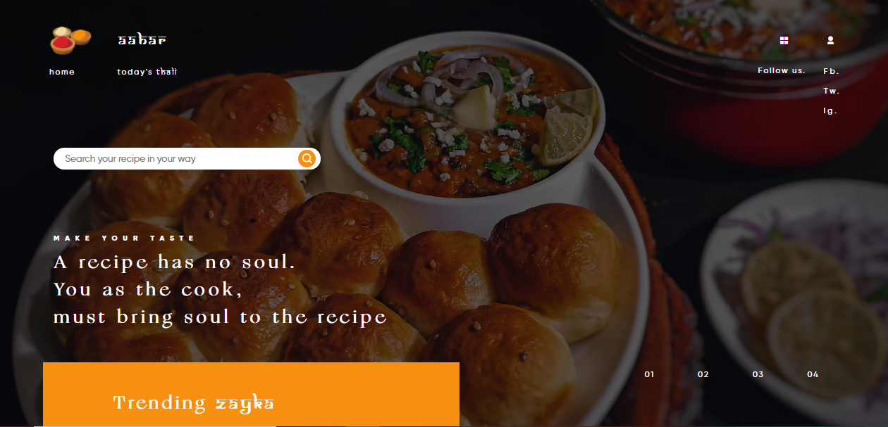
Home page view

Slide 11
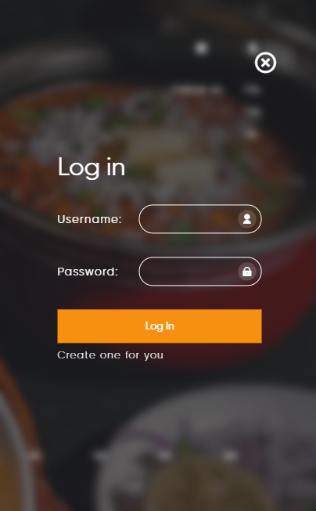
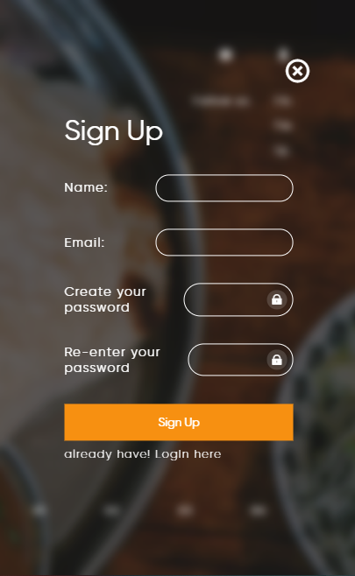
Login and Sign Up page view

Slide 12
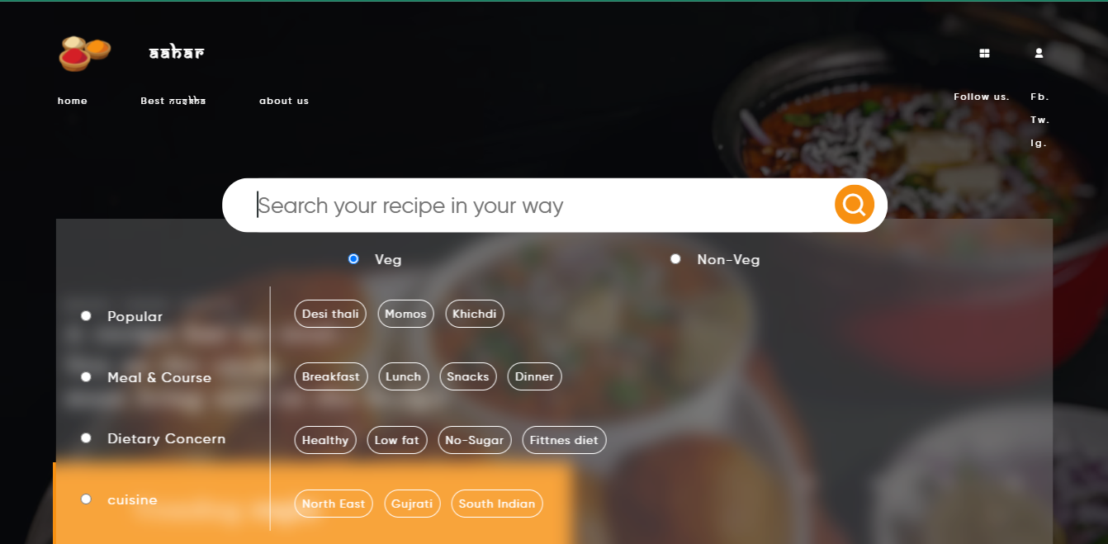
Search Bar view

Slide 13
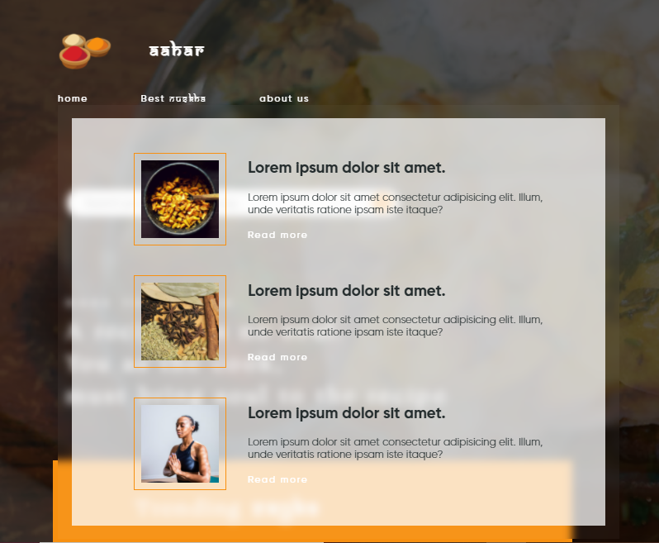
Expert Advice portion view

Slide 14
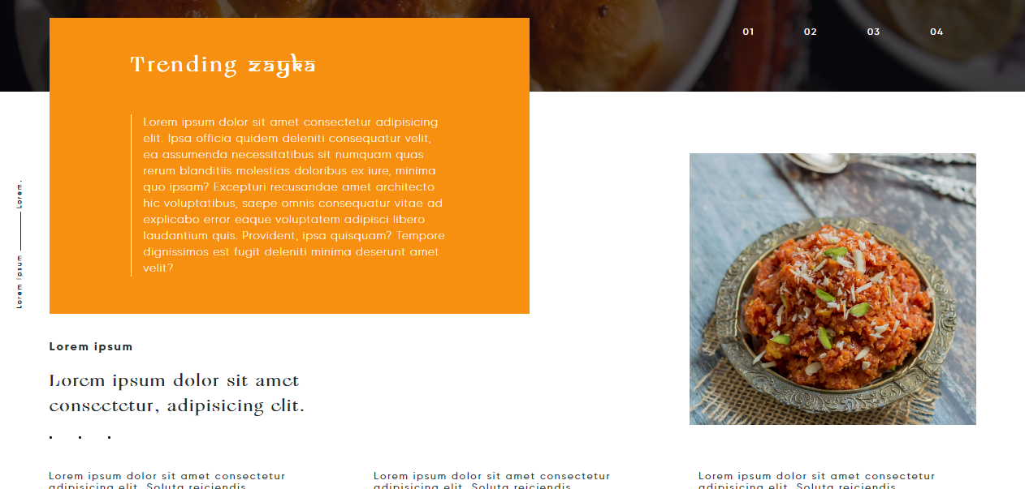
Daily feeds

Slide 15
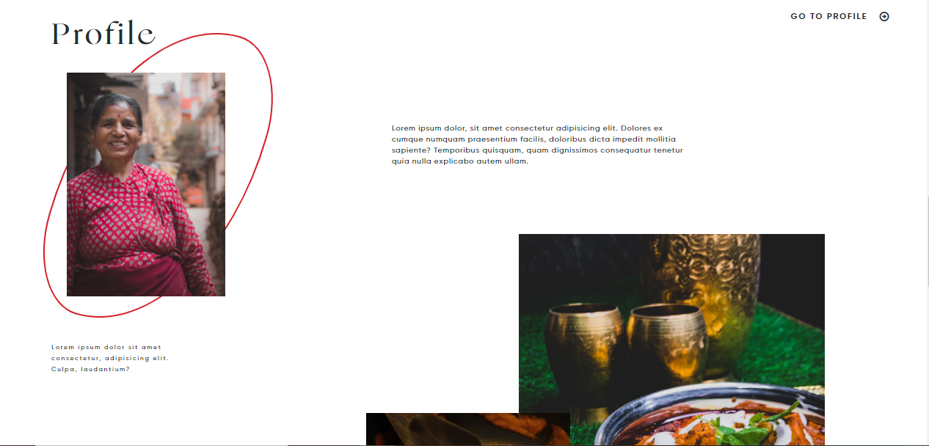
Profile

Slide 16
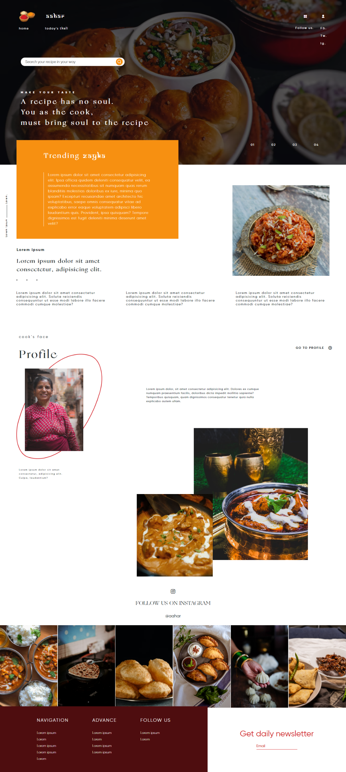
Full desktop view

Slide 17
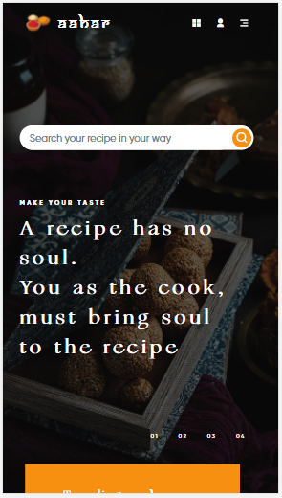
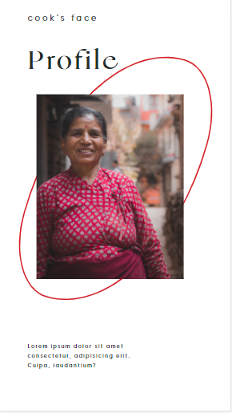
Mobile view

Slide 18
Thank you

